Slide 1
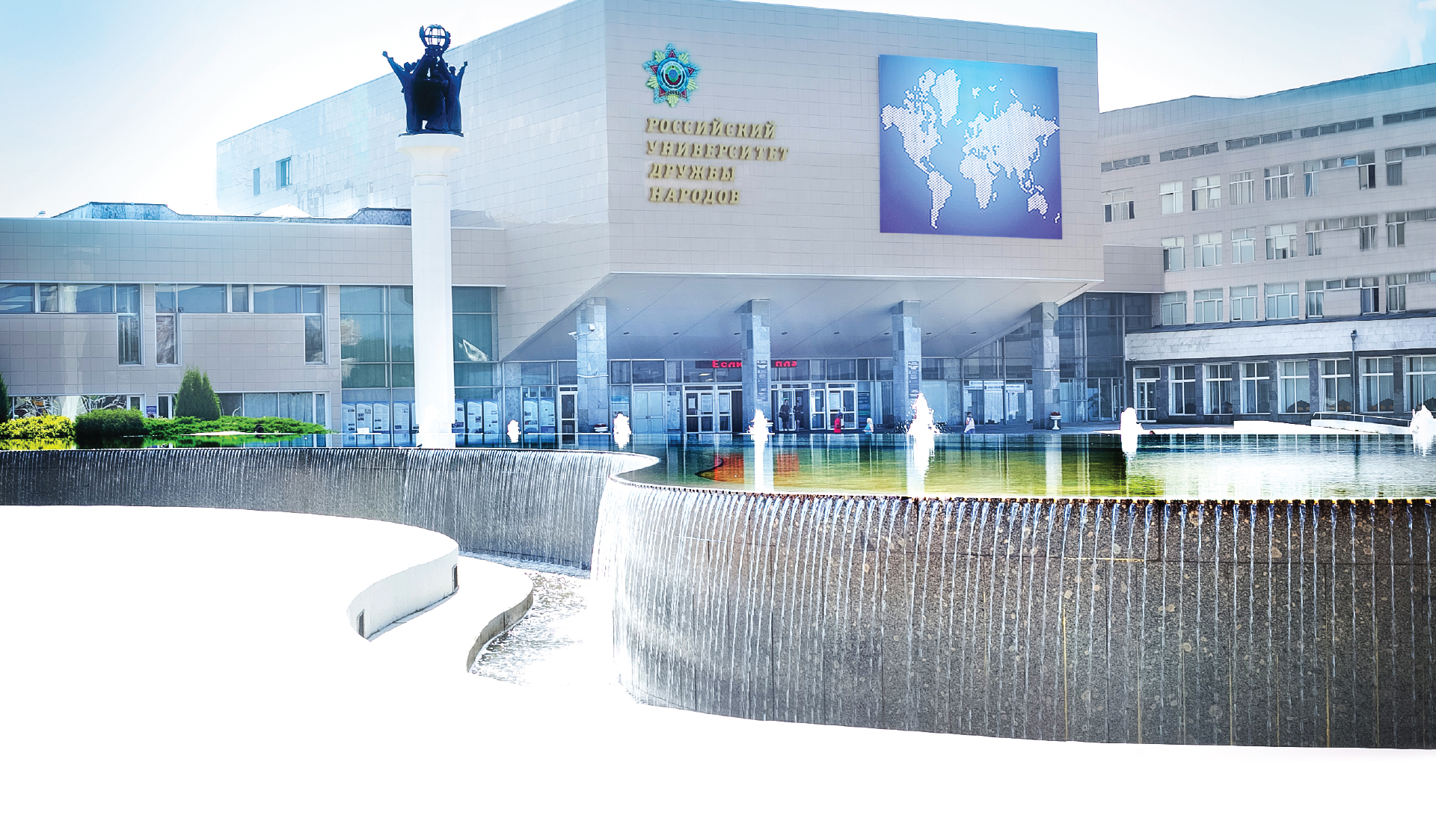
1.1.7. - Теоретическая механика, динамика машин
(Theoretical Mechanics, Machine Dynamics )

Slide 2
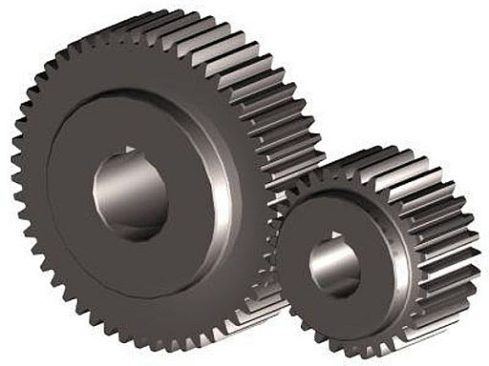
POSTGRADUATE PROGRAM 1.1.7. - Теоретическая механика, динамика машин
(Theoretical Mechanics, Machine Dynamics )
The purpose of the program is the training of highly qualified scientific and scientific–pedagogical person, the formation and development of their competencies in the field of theoretical mechanics, machine dynamics in accordance with the professional standard; solving scientific problems of fundamental and applied importance.
The duration of training under the educational program, implemented in full-time, is 4 years.
The head of the program is Doctor of Technical Sciences, Professor, Professor of Department of Nanotechnology and Microsystem Engineering of Academy of Engineering Viktor Vasilevich Belyaev.

Slide 3
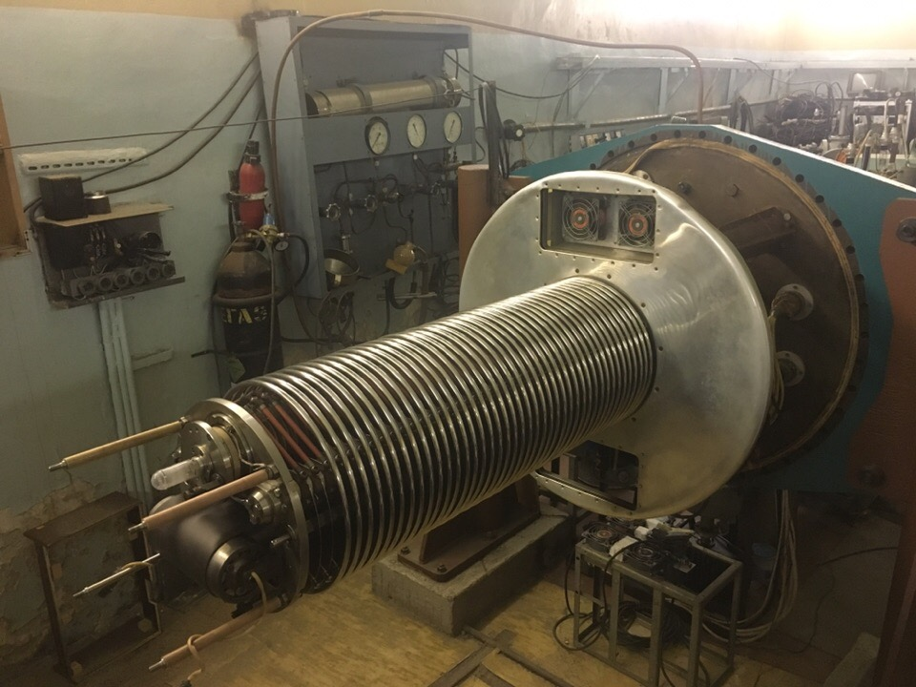
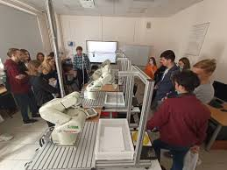
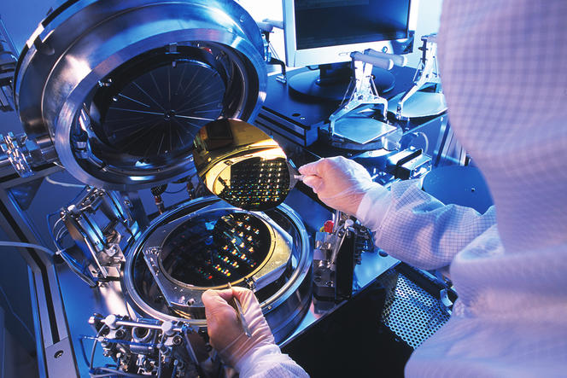

Slide 4
Entrance test
Entrance test for admission to program for the training of scientific and pedagogical personnel in postgraduate studies in the specialty 1.1.7. Теоретическая механика, динамика машин (Theoretical Mechanics, Machine Dynamics) are realized in the form of a test generated by an electronic examination support system (ESS) by random sampling of tasks from a prepared bank of test tasks, with automatic verification of ESS correctness of completed tasks (computer test).

Slide 5
Entrance test
The entire of computer test takes 100 minutes to complete.
The computer test consists of 50 questions with choice answers: with the choice of one correct answer from a set of matching questions.
For questions with the choice of one correct answer and matching questions: 2 points are awarded for the correct answer, zero for the wrong one.

Slide 6
Entrance test
It is necessary on the exam:
demonstrate knowledge of the basic of mathematical analysis, reliability theories
demonstrate proficiency in professional knowledge and terminology in the field of applied mechanics

